Slide 1

BANK Team Profile

Slide 2

Below Average | 28%
Average | 52%
Above Average | 20%

Slide 3
Brain Fitness Level
Drivers that Influence Brain Performance
52% (13/25) of the Team is below acceptable level of Fitness
20% (5/25) of the team is at acceptable level
28% (7/25) at very low levels of brain fitness
NO ONE IS FIT
As a team Brain Fitness is at 58 % (Borderline)
Immediate Interventions
- Bi-Lateral Brain Function
- Movement/Exercise
- Brain Food
- Sleep
Attitude is Positive

Slide 4
Left Brain Dominance | 60%
Right Brain Dominance | 40%

Slide 5
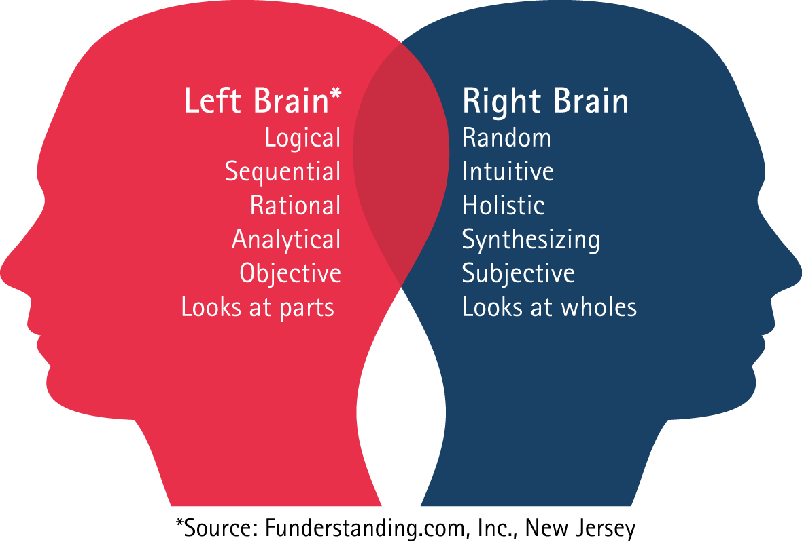
Left Brain Dominance | 60%
Right Brain Dominance | 40%
Bilateral | 24%

Slide 6
60% Left Brain Dominant
-Computer Like Manner
-Logical
-Sequential Thinking
-Number Oriented
-Language Oriented
-Time Conscious
-Goals Oriented
-Very Black/White
-Structured
-Prefer Talking & Writing
-Control Feelings
-Prefer Ranked Authority
Make It Happen Attitude
40% Right Brain Dominant
-Big Picture People
-Intuitive
-Fluent & Spontaneous
-Faces & Pictures
-Feeling & Experience
-Less Time Conscious
-Free Flowing
-Flexible & Tolerant
-Self Acting
-Drawing
-Free with feelings
-Participative Authority
Let It Happen Attitude

Slide 7
40% Emotional
-Feeler (Emotional)
-Instinctive Reaction
-People Oriented
-Subjective
-Learn through Experience
60% Rational
-Rational (Logical)
-Intellectual
-Task Oriented
-Objective
-Fact Oriented
-Think too much
Majority of the team would be
-Logical & Practical
-No Gut Feel Decision rather Fact Oriented Decisions
-Good Decision Making Ability
-Not Emotionally Intelligent
-Not very people oriented decisions

Slide 8
34 % Expressive
-Language
-Talkative
-Outspoken
-Ask Questions
-Participative
64% Receptive
-Absorbent
-Reserved
-Think before act
-Work alone
-Individualistic
Majority of the team would be
-Quiet & Reserved
-Not Sharing
-Not playing a collaborative role
-Working in Silos
-Not Participative

Slide 9
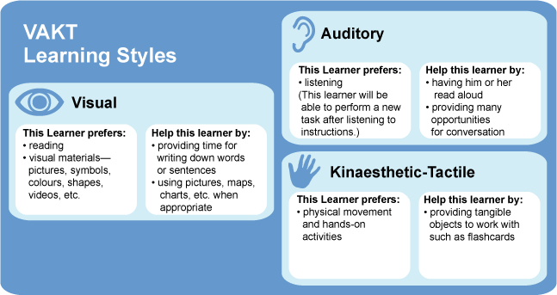

Slide 10
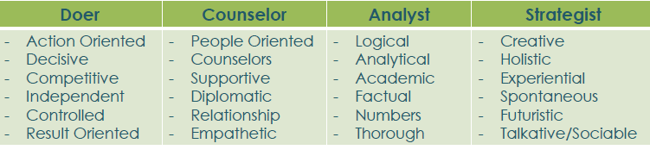
Strategist | 16%
Analyst | 12%
Counselors | 12%
Doers | 20%
Balanced | 16%

Slide 11
Team Quadrant
Vinodhini
Merryhan
Nazario
Rahim
Analyst
Strategist
Prem
Dhari
Ashish
Maria
Sangini
Adeel
Ramesh
Revathy
Luis
Mohammad
Doer
Counselor

Slide 13
Recommendations
Improve Brain Fitness Level
•Develop Bi-Lateral Brain Approach
•Movement & Exercise
•Brain Food
Build Balance Between
•Brain Dominance (Bi-Lateral)
•Rational & Emotional
•Expressive & Receptive
•4 Quadrants
Future Learning Recommendations
Brain Based Team Development ( 2 days workshop)
Neuro-agility intervention (2 days workshop % e-learning)

